Slide 1

Lecture 5 loops
PROGRAMMING 1
(CS 102)
5
Fall (2025-2026)

Slide 2
Course Learning Objectives
Explain and define fundamental programming concepts, including variables, data types, the sequential nature of program execution, and basic program input/output (I/O).
Trace and debug simple programs to identify and correct basic syntax and logical errors.
Apply basic programing concepts, such as conditional statements, loops, and functions, to solve small scale computational problems.
Decompose problems into smaller, manageable subroutines, and implement basic functions to enhance code modularity and reusability.
Collaborate with peers Work in a team to design and implement a software project that meets specific functional requirements.

Slide 3

Lecture 5: loops
Content
C++ Loops

Slide 4
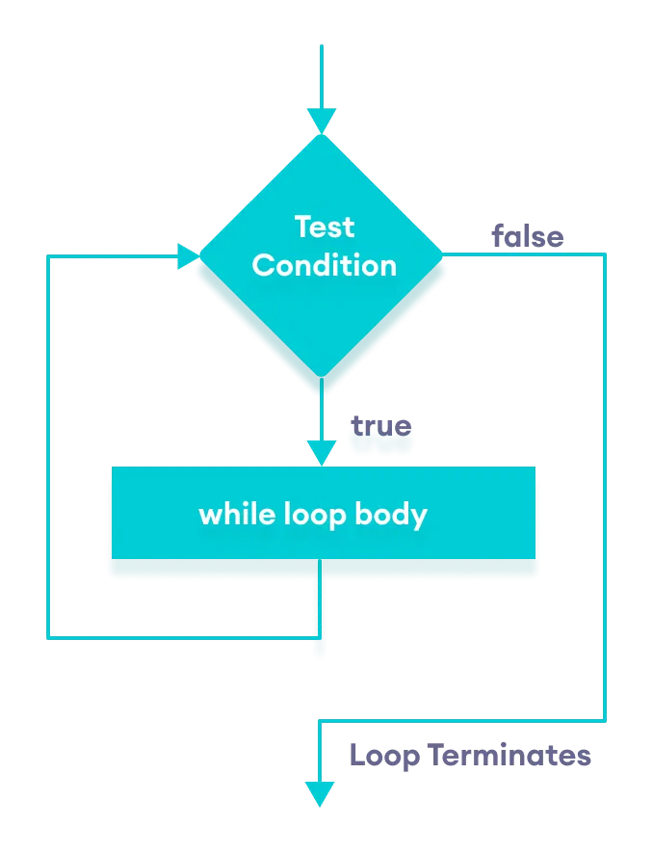
C++ Loops
  Loops can execute a block of code as long as a specified condition is reached.
There are 3 types of loops in C++.
  while loop
  do...while loop
  for loop
  1) C++ While Loop
  The while loop loops through a block of code as long as a specified condition is true:
  while (condition)
  {
  // code block to be executed
  }

Slide 5
C++ Loops
  1) C++ While Loop
  Example: C++ Program to print numbers from 1 to 5
#include <iostream>
using namespace std;
int main() {
int i = 0;
while (i < 5)
{
cout << i << "\n";
i++;
}
return 0;
}

Slide 6
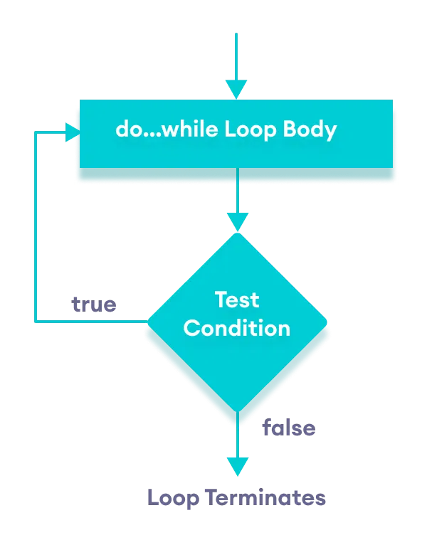
C++ Loops
  2) Do/While Loop
  The do/while loop is a variant of the while loop. This loop will execute the code block once, before checking if the condition is true, then it will repeat the loop as long as the condition is true.
  do
  {
  // code block to be executed
  }
  while (condition);

Slide 7
C++ Loops
  2) Do/While Loop Example
  The example below uses a do/while loop. The loop will always be executed at least once, even if the condition is false, because the code block is executed before the condition is tested:
int i = 0;
do {
cout << i << "\n";
i++;
}
while (i < 5);

Slide 8
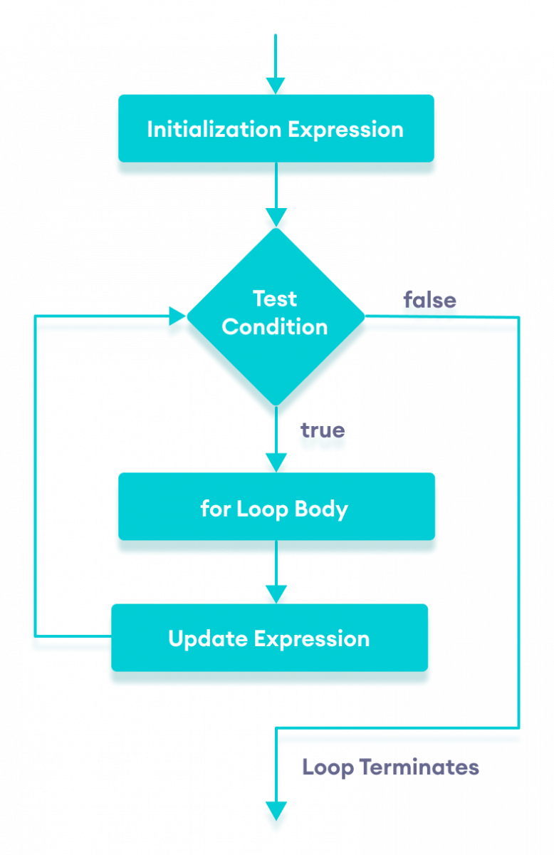
C++ Loops
  3) C++ For Loop
  When you know exactly how many times you want to loop through a block of code, use the for loop instead of a while loop:
  for (initial value; condition; step)
  {
  // code block to be executed
  }
for (int i = 0; i < 5; i++)
{
cout << i << "\n";
}

Slide 9
C++ Loops
  3) C++ For Loop
  Example: This example will only print even values between 0 and 10:
for (int i = 0; i <= 10; i = i + 2)
{
cout << i << "\n";
}

Slide 10
C++ Break and Continue
C++ Break
The break statement can also be used to jump out of a loop.
C++ Continue
The continue statement breaks one iteration (in the loop), if a specified condition occurs, and continues with the next iteration in the loop.

Slide 11
C++ Break and Continue
C++ Break
This example jumps out of the loop when i is equal to 4:
C++ Continue
This example skips the value of 4:
for (int i = 0; i < 10; i++) {
if (i == 4) {
break;
}
cout << i << "\n";
}
for (int i = 0; i < 10; i++) {
if (i == 4) {
continue;
}
cout << i << "\n";
}

Slide 12
Break and Continue in While Loop
You can also use break and continue in while loops:
Break example:
int i = 0;
while (i < 10) {
cout << i << "\n";
i++;
if (i == 4) {
break;
}
}

Slide 13
Break and Continue in While Loop
You can also use break and continue in while loops:
Continue example:
int i = 0;
while (i < 10) {
if (i == 4) {
i++;
continue;
}
cout << i << "\n";
i++;
}

Slide 14
Example
Example 2: Sum of Positive Numbers Only –if the user enters a negative number, the loop ends
#include <iostream>
using namespace std;
int main() {
int number;
int sum = 0;
cout << "Enter a number: "; // take input from the user
cin >> number;
while (number >= 0) {
sum += number; // add all positive numbers
cout << "Enter a number: "; // take input again if the number is positive
cin >> number;
}
cout << "\nThe sum is " << sum << endl; // display the sum
return 0;
}

Slide 15
Example
Example 3: Calculate the sum of numbers in a range
from 10 to 1000 and not divisible by 7.
#include <iostream>
using namespace std;
int main() {
int sum = 0;
for (int i = 10 ; i <= 1000 ; ++i)
{
if (i % 7 != 0) {
sum += i;
}
}
cout << "\nThe sum is " << sum << endl; // display the sum
return 0;
}

Slide 16



